Slide 1
Lesson 00.04
place-image versus overlay-xy

Slide 2
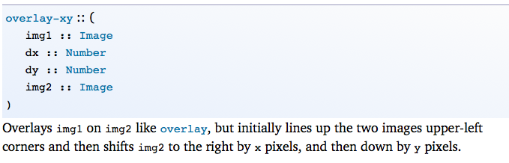
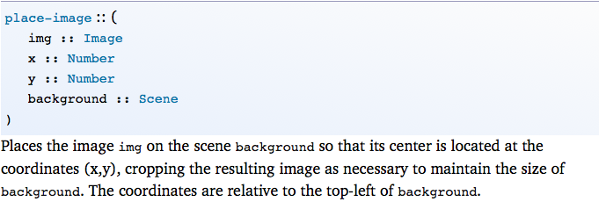
Compare overlay-xy to place-image

Slide 3
Compare overlay-xy to place-image
What is the contract for overlay-xy?

Slide 4
Compare overlay-xy to place-image
Go to pyret and write an example of overlay-xy

Slide 5
What is the contract for rotate?

Slide 6
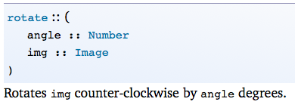
What is the contract for rotate?

Slide 7
What is the contract for rotate?
GO TO PYRET AND WRITE AN EXAMPLE OF ROTATE

Slide 8
Guidelines
Do not copy and paste any code!
If you do, you’re not thinking abstractly.
Use pyret.org/docs
and docs.racket-lang.org to learn more about the image functions you are using.

Slide 9
Solve the following problems with your partner.
# image 0

Slide 10
Switch partners; slide your keyboard

Slide 11
Solve the following problems with your partner.
# image 1

Slide 12
Switch partners; slide your keyboard

Slide 13
Solve the following problems with your partner.
# image 2

Slide 14
Switch partners; slide your keyboard

Slide 15
Solve the following problems with your partner.
# image 3

Slide 16
Switch partners; slide your keyboard

Slide 17
Solve the following problems with your partner.
# image 4

Slide 18
Switch partners; slide your keyboard

Slide 19
Solve the following problems with your partner.
# image 5

Slide 20
Switch partners; slide your keyboard

Slide 21

Challenge! Get as close as you can.
# image 6

